Slide 1
Operating Systems
Chittaranjan Mahajan

Slide 2
Inter-process Communication
Process frequently need to communicate.
Ex. The output of first process must be passed to the second process.
No two or more processes do not get in each others way.
Ex. Airline Reservation system.
Proper sequencing when dependencies are present.
Ex. Read from ADC then write to Display.

Slide 3
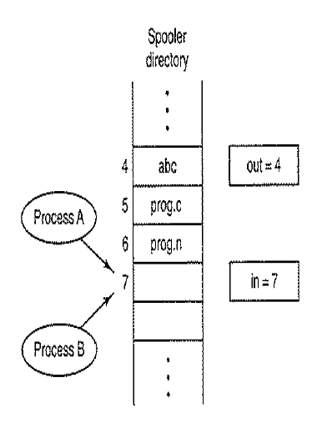
Race Condition
Situation where two or more processes are reading or
writing some shared data and the final result depends
on who runs precisely when are called race condition.

Slide 4
Critical Regions
The part of the program where the shared memory is accessed is called the critical region or critical section.

Slide 5
Critical Regions
No two processes may be simultaneously inside their critical regions.
No assumptions may be made about speeds or the number of CPUs.
No process running outside its critical region may block other processes.
No process should have to wait forever to enter its critical region.

Slide 6
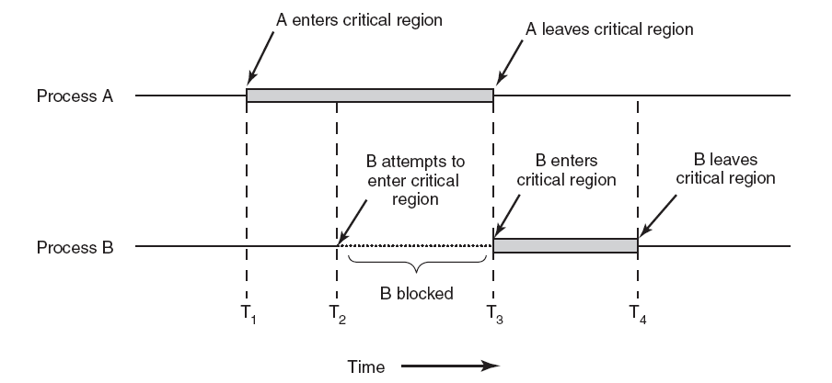
Critical Regions
Figure 2-22. Mutual exclusion using critical regions.

Slide 7
Mutual exclusion
It is a way of a making sure that if one process is using a shared variable or file , the other process will be excluded from doing the same thing.

Slide 8
It is a program object that prevents simultaneous access to a shared resource.
Concept used in concurrent programming by taking care of CRITICAL SECTION ( it is a piece of code in which processes or threads access a shared resource)

Slide 9
Arrange resources such that NO TWO PROCESSES EVER ENTER IN THEIR CRITICAL SECTION / REGION

Slide 10
Mutual Exclusion Conditions
No two processes may at the same moment inside their critical section
No assumptions are made about relative speeds of processes or no of CPUs
No processes outside its critical region should block / occupy other resources/processes
No processes should wait long time to enter its critical section (discard)

Slide 11
Proposals for achieving mutual exclusion
Disabling interrupts
Lock variables
Strict alternation
Peterson's solution
The TSL instruction

Slide 12
Disabling interrupts
Disable interrupt before entering in critical region
What will happen if process forget to enable interrupt?
What will happen in multicore envoirnment?.

Slide 13
Lock variables
Use single , shared Lock variable.
Lock variable will be initially 0.
When process want to enter in critical region
It first test the lock.
If lock is 0,process set it to 1 and enters in
Critical region.
If lock is 1, process wait until it becomes 0.
Race around.

Slide 14
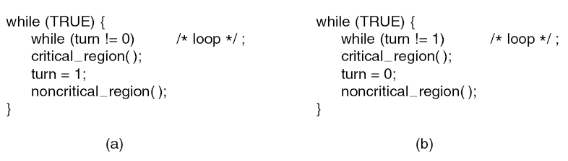
Strict Alternation
Spin lock problem ,wastage of CPU cycles.

Slide 15
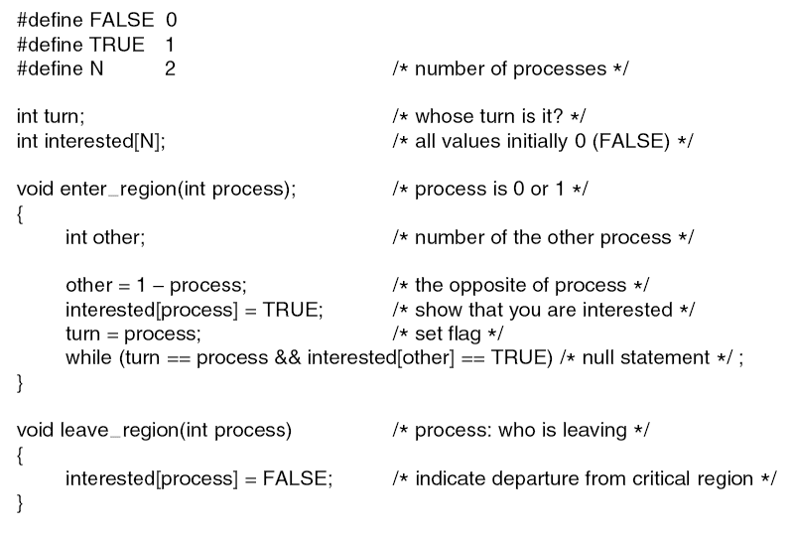
Peterson's Solution
Peterson’s solution for achieving mutual exclusion.
Multiple keys.

Slide 16
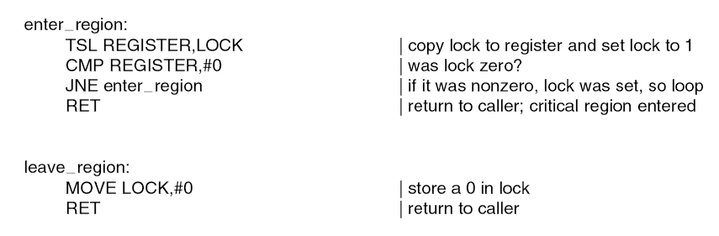
The TSL Instruction test and set lock
It reads a contents of memory word lock into register RX and store s a nonzero value at the memory address lock

Slide 17
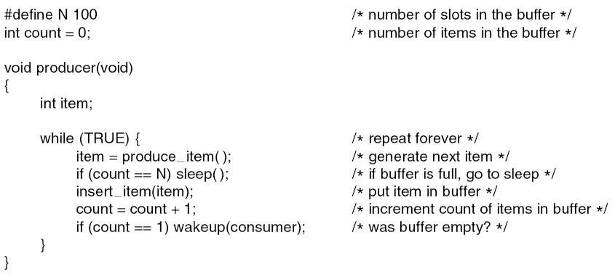
The Producer-Consumer Problem (1)
Read ADC and Display Routine problem.
. . .

Slide 18
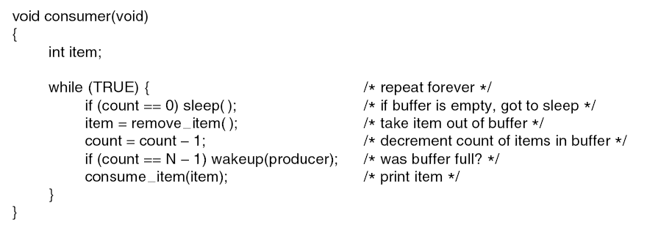
The Producer-Consumer Problem (2)
. . .
Figure 2-27. The producer-consumer problem with a fatal race condition.

Slide 19
Semaphore
New and significant technique for managing concurrent processes using VARIABLS called as SEMAPHORE
It is used to solve critical region problem & to achieve process synchronization in multi processing environment
Semaphore is an object that consists of counter , waiting list of processes ( and two methods WAIT and SIGNAL)

Slide 20
Wait : Decrement the value of its argument S as soon as it would become non-negative
Signal : Increment the value of its argument , S as an individual operation

Slide 21
Types of Semaphore
Binary Semaphore
Counting Semaphore
Properties of SEMAPHORE
Simple
Works with many processes

Slide 22
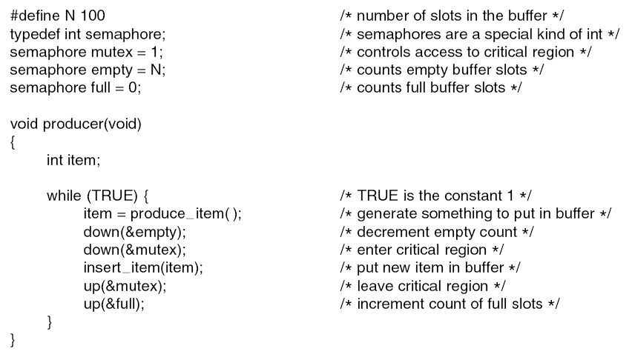
Semaphores (1)
. . .

Slide 23
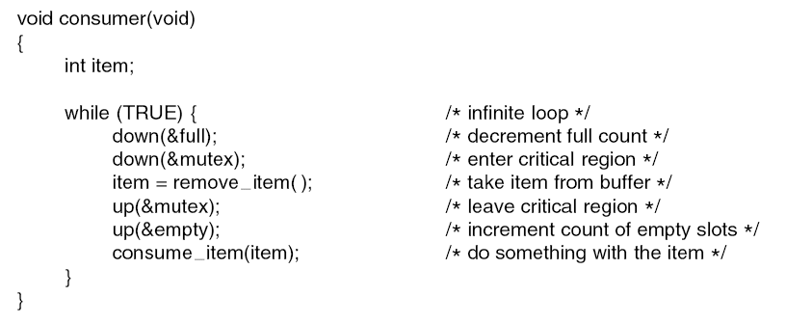
Semaphores (2)
. . .
Figure 2-28. The producer-consumer problem using semaphores.

Slide 24
Classical Problems of Synchronization
Synchronization problems are present as example of a large class of concurrency-control problems.
These are used for testing newly proposed synchronization scheme. We use semaphores for synchronization.

Slide 25
1. Readers – Writers
2. Producer Consumer Problem
3. Dining Philosopher Problem

Slide 26
Readers writers problem
Database is shared among several concurrent processes
Some pro may want only to read the database while others may need to update the same
Former : Reader
Latter : Writer

Slide 27
If two readers access the shared data simultaneously , no effect but if one or two writers access the database , it may create problem
Many readers may access the object concurrently , but if a writer is accessing the object no other process may access the object

Slide 28
First Readers Writers Problem
Readers have priority over writers
Here writer may need to wait for a long time also

Slide 29
Second Readers Writers Problem
Writers have priority over readers
When a writer wants to access the object , only readers which have already obtained permission to access the object are allowed to complete their access. Any reader requesting access after writer must wait until writer is finishing the task
Reader may need to wait

Slide 31
Producer Consumer Problem
Two processors :
ONE is PRODUCER
OTHER is CONSUMER
Both run concurrently and share a common buffer
Producer generated items are consumed by customer

Slide 35
Dining Philosopher Problem
They share a circular table surrounded by 5 chairs
At the centre 5 resources
If resources are being used by another process , other process becomes helpless to use required resource

Slide 37
Preemptable and Nonpreemptable Resources
Sequence of events required to use a resource:
Request the resource.
Use the resource.
Release the resource.

Slide 38
Conditions for Resource Deadlocks
Mutual exclusion condition
Each resource is either currently assigned to exactly one process or is available.
2. Hold and wait condition.
Process currently holding resources that were granted earlier can request new resources.
No preemption condition.
Resources previously granted cannot be forcibly taken away from the process.
Circular wait condition.
each one is waiting for a resource held by the next member.

Slide 39
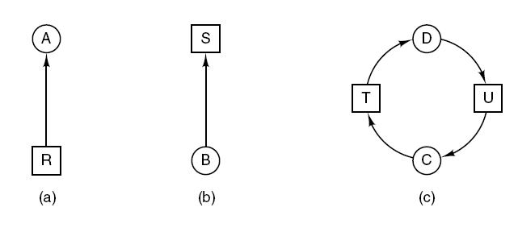
Deadlock Modeling (1)
Figure 6-3. Resource allocation graphs. (a) Holding a resource. (b) Requesting a resource. (c) Deadlock.

Slide 40
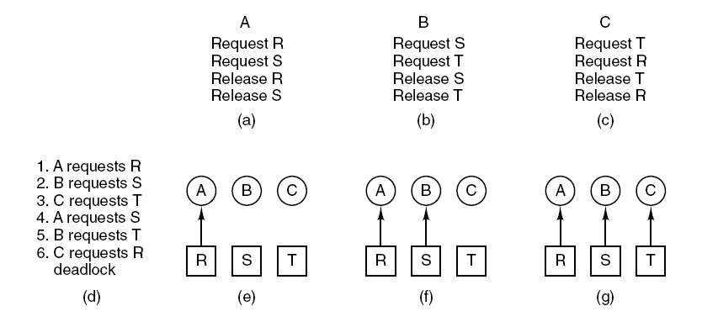
Deadlock Modeling (2)
Figure 6-4. An example of how deadlock occurs and how it can be avoided.

Slide 41
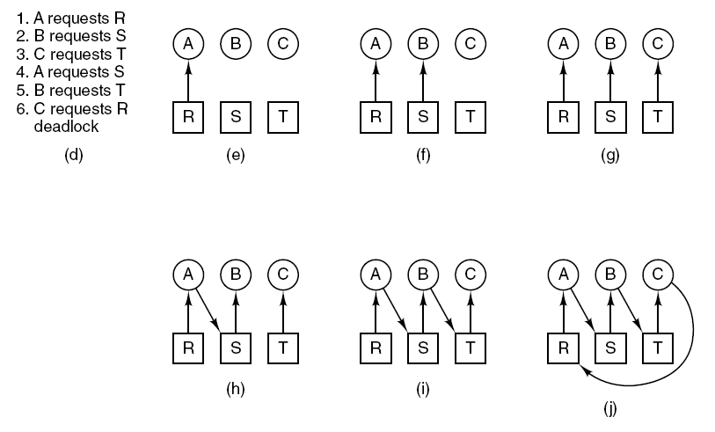
Deadlock Modeling (3)
Figure 6-4. An example of how deadlock occurs and how it can be avoided.

Slide 42
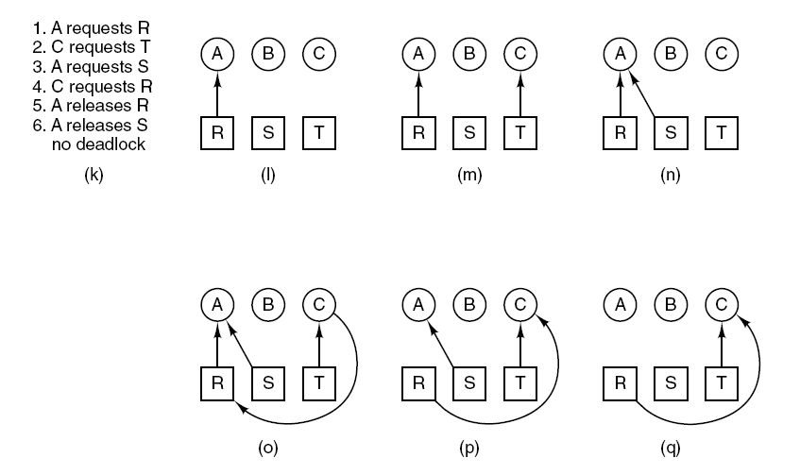
Deadlock Modeling (4)
Figure 6-4. An example of how deadlock occurs and how it can be avoided.

Slide 43
Deadlock Modeling (5)
Strategies for dealing with deadlocks:
Just ignore the problem.
Detection and recovery. Let deadlocks occur, detect them, take action.
Dynamic avoidance by careful resource allocation.
Prevention, by structurally negating one of the four required conditions.

Slide 44
Ostrich algorithm

Slide 45
Recovery from Deadlock
Recovery through preemption
Recovery through rollback (check point)
Recovery through killing processes

Slide 46
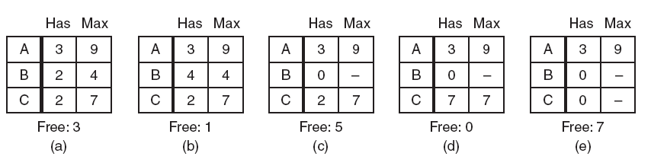
Safe and Unsafe States (1)
Figure 6-9. Demonstration that the state in (a) is safe.

Slide 47
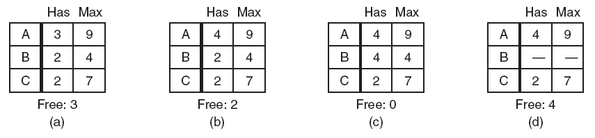
Safe and Unsafe States (2)
Figure 6-10. Demonstration that the state in (b) is not safe.

Slide 48
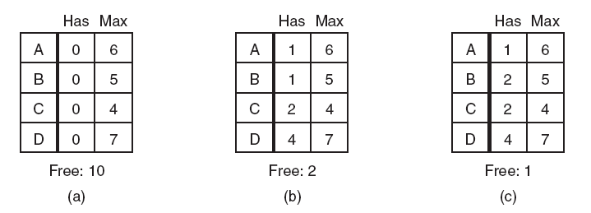
The Banker’s Algorithm for a Single Resource
Figure 6-11. Three resource allocation states: (a) Safe. (b) Safe. (c) Unsafe.

Slide 49
Deadlock Prevention
Attacking the mutual exclusion condition
Attacking the hold and wait condition
Attacking the no preemption condition
Attacking the circular wait condition

Slide 50
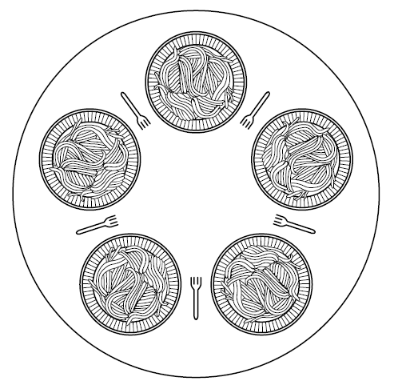
Dining Philosophers Problem (1)
Figure 2-44. Lunch time in the Philosophy Department.

